Slide 1
Blockchain-Enabled Security in Electric Vehicles Cloud and Edge Computing
Blockchain-Enabled Security in Electric Vehicles Cloud and Edge Computing
Midhun S
Class No: 38 S7 BTECH CSE
21/11/2018
Dept. of CSE, MACE Kothamanglam
1

Slide 2
Blockchain-Enabled Security in Electric Vehicles Cloud and Edge Computing
CONTENTS
Introduction
Network Architecture of EVCE Computing
Context Aware Vehicular Applications
Distributed Consortium Blockchain
Security Interactions in EV Cloud Computing
21/11/2018
Dept. of CSE, MACE Kothamanglam
2
Notes:
2

Slide 3
Blockchain-Enabled Security in Electric Vehicles Cloud and Edge Computing
CONTENTS(Contd...)
Security Interactions in EV Edge Computing
Security Interactions in EV Cloud Computing
Conclusion
References
21/11/2018
Dept. of CSE, MACE Kothamanglam
3
Notes:
3

Slide 4
Blockchain-Enabled Security in Electric Vehicles Cloud and Edge Computing
INTRODUCTION
EVCE
Attractive paradigm having seamless connection
Information and energy flow by V2X
V2X Communications include V2I ,V2V,V2G
Information analysis and data sharing.
21/11/2018
Dept. of CSE, MACE Kothamanglam
4

Slide 5
Blockchain-Enabled Security in Electric Vehicles Cloud and Edge Computing
INTRODUCTION(contd..)
Information interaction through RSU
Energy Interaction through LAG
Center less trust
Collaborative Intelligence
Spatio-Temporal Sensitivity
21/11/2018
Dept. of CSE, MACE Kothamanglam
5

Slide 6
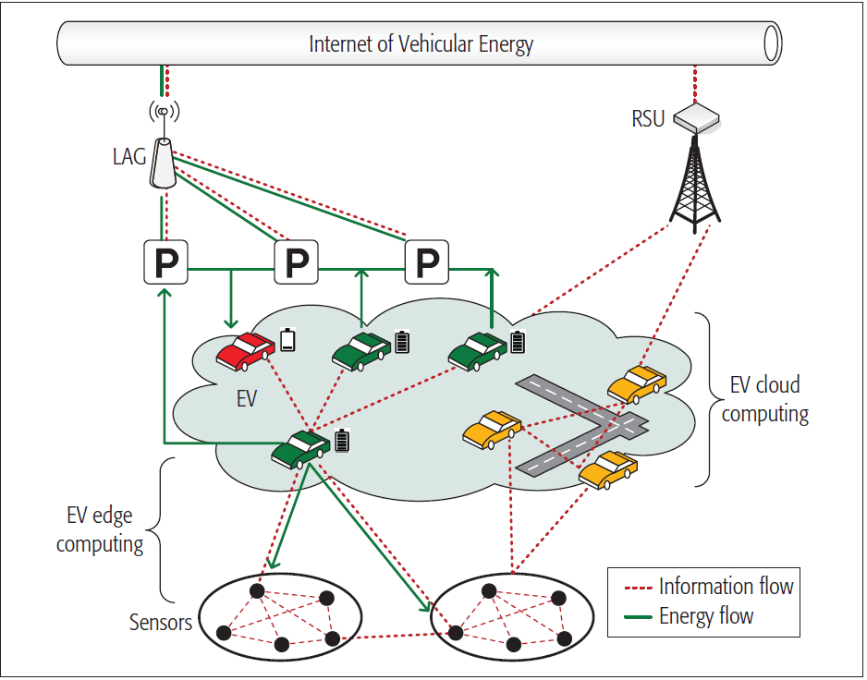
Blockchain-Enabled Security in Electric Vehicles Cloud and Edge Computing
Network Architecture
Courtesy:- https://ieeexplore.ieee.org/document/6234023#Figures
21/11/2018
Dept. of CSE, MACE Kothamanglam
6

Slide 7
Blockchain-Enabled Security in Electric Vehicles Cloud and Edge Computing
Network Architecture(contd..)
EV Cloud Computing
EVs idle energy, computation & communication
EV is regarded as mobile cloudlets
Connected EV providing cooperative services
Help to establish connection with RSU & LAG
21/11/2018
Dept. of CSE, MACE Kothamanglam
7

Slide 8
Blockchain-Enabled Security in Electric Vehicles Cloud and Edge Computing
Network Architecture(contd..)
EV Edge Computing
EV as Data processing and analysis unit
Sensors establish connection with EV
Flexible computing
Low communication latency
Higher accuracy on measurement
21/11/2018
Dept. of CSE, MACE Kothamanglam
8

Slide 9
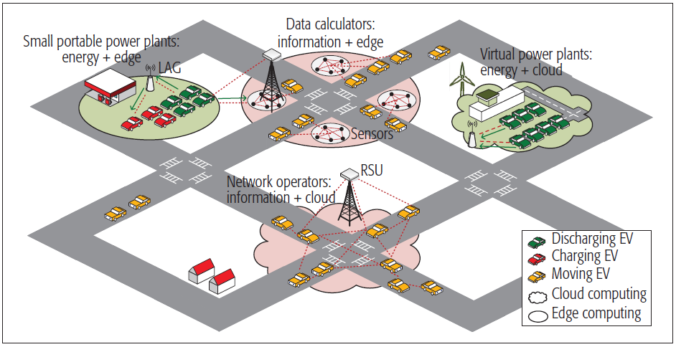
Blockchain-Enabled Security in Electric Vehicles Cloud and Edge Computing
Context Aware Vehicular Application
Courtesy:- https://ieeexplore.ieee.org/document/6234023#Figures
21/11/2018
Dept. of CSE, MACE Kothamanglam
9

Slide 10
Blockchain-Enabled Security in Electric Vehicles Cloud and Edge Computing
Context Aware Vehicular Application
(Contd..)
Four Scenarios
Spontaneous network operator
Mobile data calculators
Virtual power plants
Small portable power plants
21/11/2018
Dept. of CSE, MACE Kothamanglam
10

Slide 11
Blockchain-Enabled Security in Electric Vehicles Cloud and Edge Computing
Context Aware Vehicular Application
(Contd..)
Spontaneous Network Operators
Slowly moving EVs act as network operators
Carrying and forwarding data packets
V2I and V2V Communication
Interactions with RSU
Monitoring roadside infrastructure
Data driven interaction provide network connectivity
21/11/2018
Dept. of CSE, MACE Kothamanglam
11

Slide 12
Blockchain-Enabled Security in Electric Vehicles Cloud and Edge Computing
Context Aware Vehicular Application (Contd..)
Mobile data calculators
EV as mobile data calculator
Provide local data processing
Extracting valuable information
Road detection
Traffic optimization
21/11/2018
Dept. of CSE, MACE Kothamanglam
12

Slide 13
Blockchain-Enabled Security in Electric Vehicles Cloud and Edge Computing
Context Aware Vehicular Application (Contd..)
Virtual Power Plant
Role of mobile energy transporter
Balancing energy pools different areas
Small portable power plants
Sharing energy with roadside units
Wireless charging technology like WAVE
21/11/2018
Dept. of CSE, MACE Kothamanglam
13

Slide 14
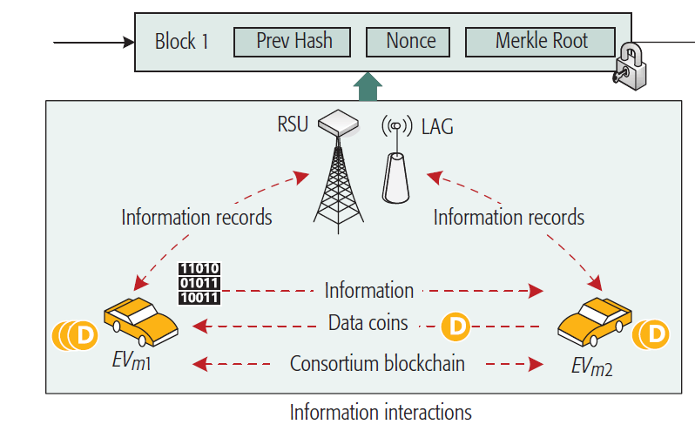
Blockchain-Enabled Security in Electric Vehicles Cloud and Edge Computing
Distributed Consensus
Courtesy:- https://ieeexplore.ieee.org/document/6234023#Figures
21/11/2018
Dept. of CSE, MACE Kothamanglam
14

Slide 15
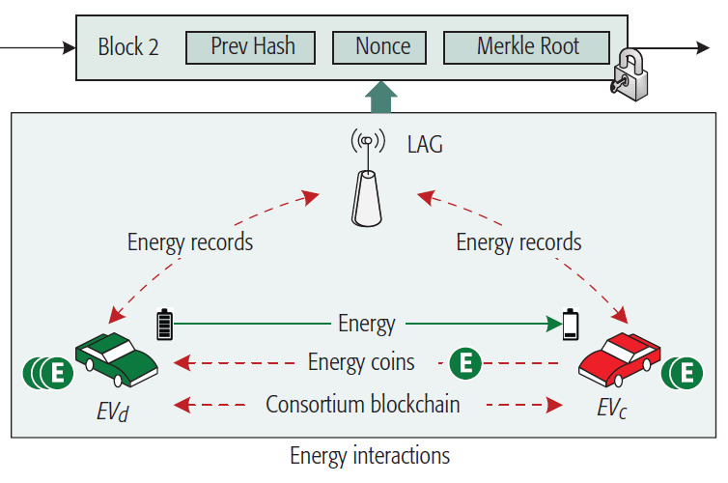
Blockchain-Enabled Security in Electric Vehicles Cloud and Edge Computing
Distributed Consensus (Contd..)
Courtesy:- https://ieeexplore.ieee.org/document/6234023#Figures
21/11/2018
Dept. of CSE, MACE Kothamanglam
15

Slide 16
Blockchain-Enabled Security in Electric Vehicles Cloud and Edge Computing
Distributed Consensus (Contd..)
Blockchain establishes distributed consensus
Before writing transaction to digital ledger
Executed by collaborative participants
It is based on Merkle root algorithm and timestamp
21/11/2018
Dept. of CSE, MACE Kothamanglam
16

Slide 17
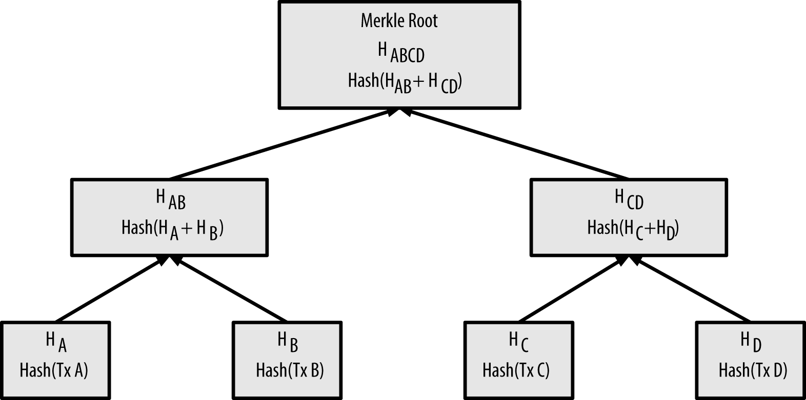
Blockchain-Enabled Security in Electric Vehicles Cloud and Edge Computing
Distributed Consensus (Contd..)
Merkle Root
Courtesy:- https://en.wikipedia.org/wiki/Merkle_root#Figures
21/11/2018
Dept. of CSE, MACE Kothamanglam
17

Slide 18
Blockchain-Enabled Security in Electric Vehicles Cloud and Edge Computing
Distributed Consensus (Contd..)
Crypto currencies used
Data coin
Energy Coin
Distributed Consensus achieved based on
Proof of Data Contribution Frequency
Proof of Energy Contribution Amount
21/11/2018
Dept. of CSE, MACE Kothamanglam
18

Slide 19

Blockchain-Enabled Security in Electric Vehicles Cloud and Edge Computing
Distributed Consensus (Contd..)
Datacoin
Data transactions
CPU Mining Coin
Data retrieved using transaction hash as identifier
Recoverable in case of data loss
Courtesy:-https://datacoin.info/pictures
21/11/2018
Dept. of CSE, MACE Kothamanglam
19

Slide 20

Blockchain-Enabled Security in Electric Vehicles Cloud and Edge Computing
Distributed Consensus (Contd..)
Energy coin
Peer to Peer crypto currency
Disruptive Blockchain technology
Platform for Sustainable Environmental Blockchain
Publically Tradable
Courtesy:-https://energycoin.info/fig
21/11/2018
Dept. of CSE, MACE Kothamanglam
20

Slide 21
Blockchain-Enabled Security in Electric Vehicles Cloud and Edge Computing
Distributed Consensus (Contd..)
Proof of Data Contribution Frequency
Data coins are defined based on this proof
Consensus process is performed by RSU or LAG
A new block will be formed for verification
EV with highest DCF will be awarded datacoins
Incentive to encourage other EV to contribute
21/11/2018
Dept. of CSE, MACE Kothamanglam
21

Slide 22
Blockchain-Enabled Security in Electric Vehicles Cloud and Edge Computing
Distributed Consensus (Contd..)
Proof of Energy Contribution Amount
Energycoins are defined based on this proof
Consensus process is performed authorized LAG
EV with most energy contribution rewarded
Energy coins are also traded among EVs
21/11/2018
Dept. of CSE, MACE Kothamanglam
22

Slide 23
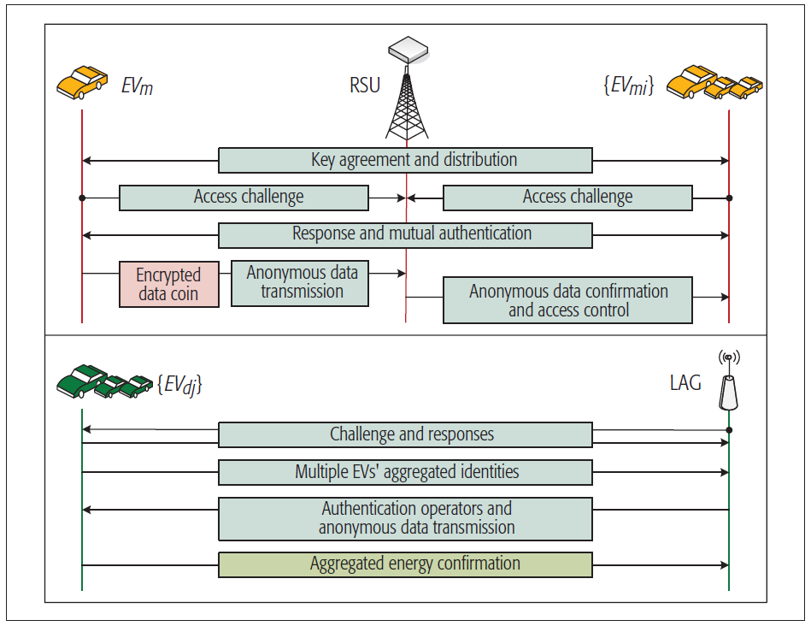
Blockchain-Enabled Security in Electric Vehicles Cloud and Edge Computing
Security Interaction in EV Cloud Computing
Courtesy:- https://ieeexplore.ieee.org/document/6234023#Figures
21/11/2018
Dept. of CSE, MACE Kothamanglam
23

Slide 24
Blockchain-Enabled Security in Electric Vehicles Cloud and Edge Computing
Security Interaction in EV Cloud Computing(Contd..)
Information Driven Security Scheme
Moving EVs perform key agreement and distribution
Establishing session keys
Interactions via access challenge
Shortest path routing be applied
Signed data broadcast to neighboring EVs
Mutual Authentication establishes
21/11/2018
Dept. of CSE, MACE Kothamanglam
24

Slide 25
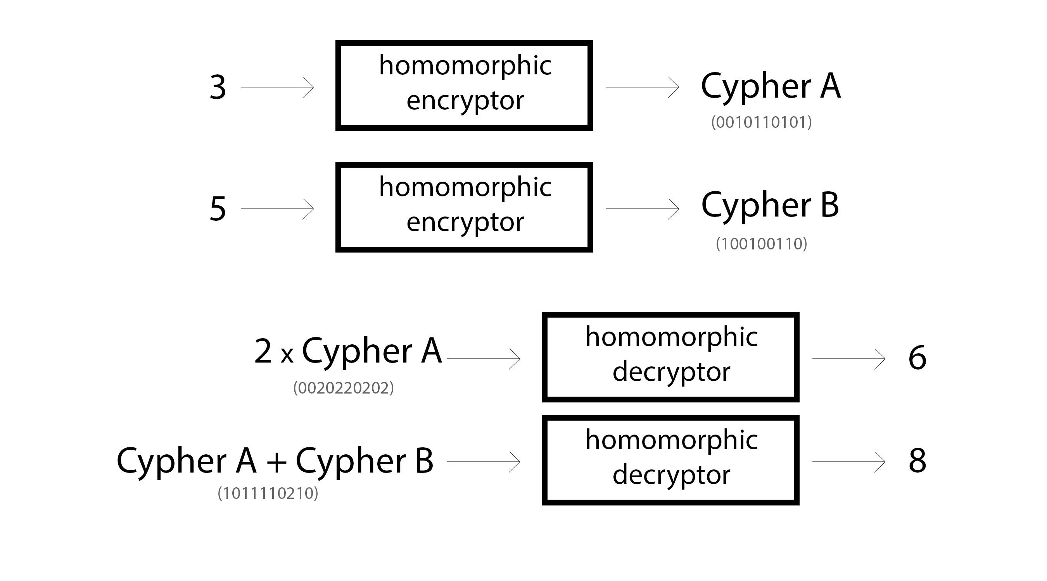
Blockchain-Enabled Security in Electric Vehicles Cloud and Edge Computing
Security Interaction in EV Cloud Computing(Contd..)
Information Driven Security Scheme
Authentication based on Homomorphic Encryption
Courtesy:-https://iamtrask.github.io/#images
21/11/2018
Dept. of CSE, MACE Kothamanglam
25

Slide 26
Blockchain-Enabled Security in Electric Vehicles Cloud and Edge Computing
Security Interaction in EV Cloud Computing(Contd..)
Energy Driven Security Scheme
Discharging EV generate pseudo random numbers
Session established between LAG and EV
LAG extracts local values
ECDSA based algorithm for data transmission
For large data structure Merkle tree Algorithm used
21/11/2018
Dept. of CSE, MACE Kothamanglam
26

Slide 27
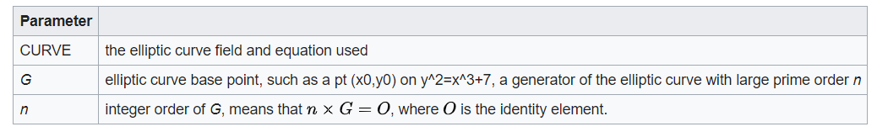
Blockchain-Enabled Security in Electric Vehicles Cloud and Edge Computing
Security Interaction in EV Cloud Computing(Contd..)
Elliptic Curve Digital Signature Algorithm
Elliptic curve version of the DSA
Twice the size of the security level
Parameters
Courtesy:-https://en.wikipedia.org/E_C_D_S_Algorithm
21/11/2018
Dept. of CSE, MACE Kothamanglam
27

Slide 28
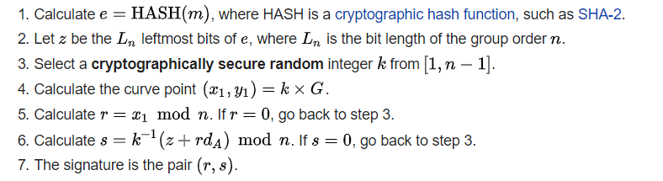
Blockchain-Enabled Security in Electric Vehicles Cloud and Edge Computing
Security Interaction in EV Cloud Computing(Contd..)
Elliptic Curve Digital Signature Algorithm
Signature Generation
Courtesy:-https://en.wikipedia.org/E_C_D_S_Algorithm
21/11/2018
Dept. of CSE, MACE Kothamanglam
28

Slide 29
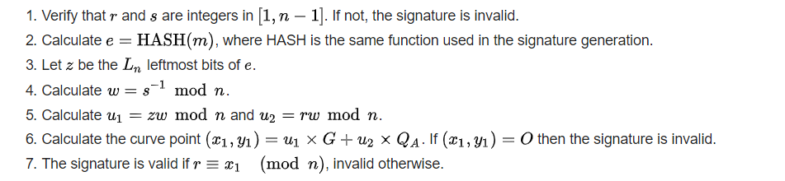
Blockchain-Enabled Security in Electric Vehicles Cloud and Edge Computing
Security Interaction in EV Cloud Computing(Contd..)
Elliptic Curve Digital Signature Algorithm
Signature Verification
Courtesy:-https://en.wikipedia.org/E_C_D_S_Algorithm
21/11/2018
Dept. of CSE, MACE Kothamanglam
29

Slide 30
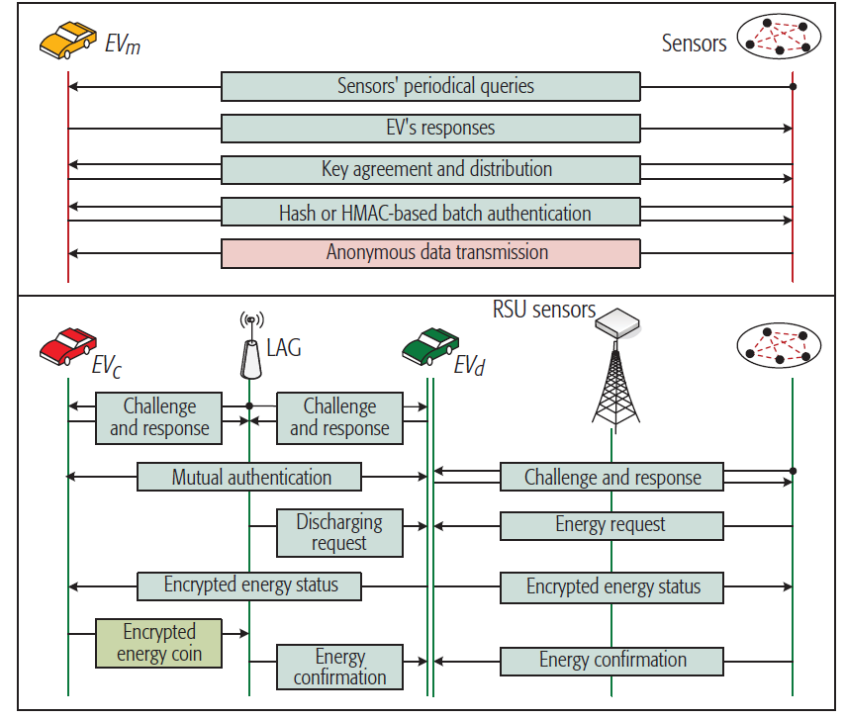
Blockchain-Enabled Security in Electric Vehicles Cloud and Edge Computing
Security Interaction in EV Edge Computing
Courtesy:- https://ieeexplore.ieee.org/document/6234023#Figures
21/11/2018
Dept. of CSE, MACE Kothamanglam
30

Slide 31
Blockchain-Enabled Security in Electric Vehicles Cloud and Edge Computing
Security Interaction in EV Edge Computing(Contd..)
Information Driven Security Scheme
Sensors constantly broadcast queries
EV giving response to periodic queries
Establishing Key Agreement
Mutual authentication based on HMAC
21/11/2018
Dept. of CSE, MACE Kothamanglam
31

Slide 32
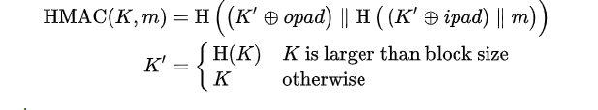
Blockchain-Enabled Security in Electric Vehicles Cloud and Edge Computing
Security Interaction in EV Edge Computing(Contd..)
Information Driven Security Scheme
HMAC
21/11/2018
Dept. of CSE, MACE Kothamanglam
32
Notes:
lrngrbnkjrbjkrsbjkb

Slide 33
Blockchain-Enabled Security in Electric Vehicles Cloud and Edge Computing
Security Interaction in EV Edge Computing(Contd..)
Information Driven Security Scheme
EV first obtain raw sensing data DATAo
EV perform processing and computing on the data
Transmitting DATAx to RSU
DATA’x will be written to digital ledger
Data coin will be assigned to appropriate EV
21/11/2018
Dept. of CSE, MACE Kothamanglam
33

Slide 34
Blockchain-Enabled Security in Electric Vehicles Cloud and Edge Computing
Security Interaction in EV Edge Computing(Contd..)
Energy Driven Security Scheme
EVd receiving the discharging request
Delivery of energy coin based on pseudonym
Coins exchanged based on distributed consensus
21/11/2018
Dept. of CSE, MACE Kothamanglam
34

Slide 35
Blockchain-Enabled Security in Electric Vehicles Cloud and Edge Computing
CONCLUSION
Security issues for both information & EI in EVCE
Data coins and energy coins are defined
Data contribution frequency
Energy contribution frequency
21/11/2018
Dept. of CSE, MACE Kothamanglam
35

Slide 36
Blockchain-Enabled Security in Electric Vehicles Cloud and Edge Computing
REFERENCES
[1] H. Li et al., “Engineering Searchable Encryption of Mobile Cloud Networks: When QoE Meets QoP,” IEEE Wireless Commun., vol. 22, no. 4, Aug. 2015, pp. 74–80.
[2] N. Kshetri, “Can Blockchain Strengthen the Internet of Things?” IT Professional, vol. 19, no. 4, 2017, pp. 68–72.
[3] A. Lei et al., “Blockchain-Based Dynamic Key Management for Heterogeneous Intelligent Transportation Systems,” IEEEInternet of Things J., 2017.
[4] N. Z. Aitzhan and D. Svetinovic, “Security and Privacy in Decentralized Energy Trading through Multi-Signatures, Blockchain and AnonymousMessaging Streams,” IEEE Trans.Dependable and Secure Computing, 2017.
21/11/2018
Dept. of CSE, MACE Kothamanglam
36

Slide 37
Blockchain-Enabled Security in Electric Vehicles Cloud and Edge Computing
THANK YOU
21/11/2018
Dept. of CSE, MACE Kothamanglam
37

